Slide 1
What is a Gradient boosting Algorithm?
The main idea behind this algorithm is to build models sequentially and these subsequent models try to reduce the errors of the previous model.
But how do we do that? How do we reduce the error? This is done by building a new model on the errors or residuals of the previous model.

Slide 2
What is a Gradient boosting Algorithm?
When the target column is continuous, we use Gradient Boosting Regressor whereas when it is a classification problem, we use Gradient Boosting Classifier. The only difference between the two is the “Loss function”.
We’ll have different loss functions like Mean squared error (MSE) for regression and for classification, we will have different for e.g log-likelihood.

Slide 3
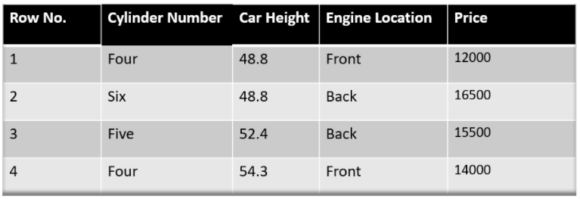
Gradient Boosting Regressor
Our target column is continuous hence we will use Gradient Boosting Regressor.
We have to predict the car price based on various features. The target column is price and other features are independent features.

Slide 4
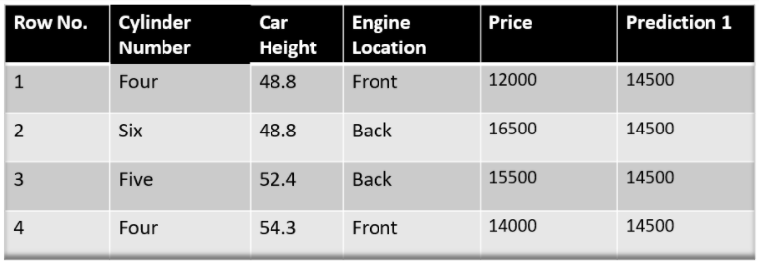
Gradient Boosting Regressor
Step -1 The first step in gradient boosting is to build a base model to predict the observations in the training dataset. For simplicity we take an average of the target column and assume that to be the predicted value as shown below:

Slide 5

Gradient Boosting Regressor
Why did I say we take the average of the target column?
Mathematically the first step can be written as:
Here L is our loss function
Gamma is our predicted value
argmin means we have to find a predicted value/gamma for which the loss function is minimum.

Slide 6

Gradient Boosting Regressor
Since the target column is continuous our loss function will be:
Here y_{i} is the observed value
And gamma is the predicted value
Now we need to find a minimum value of gamma such that this loss function is minimum.

Slide 7

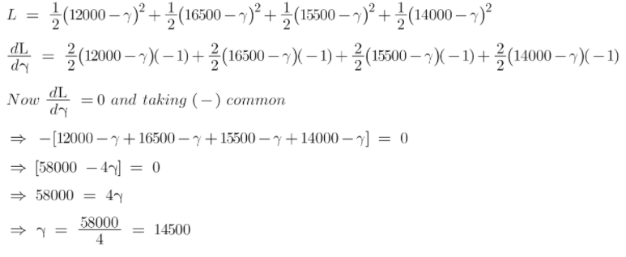
Gradient Boosting Regressor
We will use to differentiate this loss function and then put it equal to 0.

Slide 8
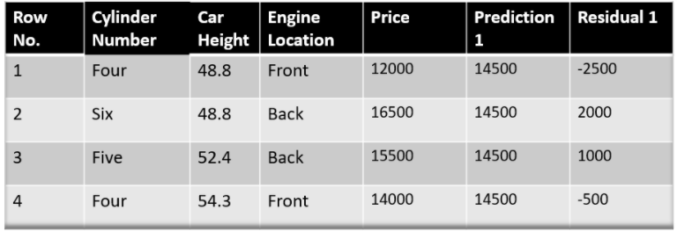
Gradient Boosting Regressor
Step-2 The next step is to calculate the pseudo residuals which are (observed value – predicted value)

Slide 9


Gradient Boosting Regressor
Again, the question comes why only observed – predicted?
We are just taking the derivative of loss function w.r.t the predicted value and we have already calculated this derivative:

Slide 10
Gradient Boosting Regressor
In the next step, we will build a model on these pseudo residuals and make predictions Because we want to minimize these residuals and minimizing the residuals will eventually improve our model accuracy and prediction power.
So, using the Residual as target and the original feature Cylinder number, cylinder height, and Engine location we will generate new predictions. Note that the predictions, in this case, will be the error values, not the predicted car price values since our target column is an error now.
Let’s say h_{m}(x) is our DT made on these residuals.

Slide 11
Gradient Boosting Regressor
Step- 4 In this step we find the output values for each leaf of our decision tree. That means there might be a case where 1 leaf gets more than 1 residual, hence we need to find the final output of all the leaves.
To find the output we can simply take the average of all the numbers in a leaf, doesn’t matter if there is only 1 number or more than 1.
why do we take the average of all the numbers?

Slide 12

Gradient Boosting Regressor
Here h_{m}(x_{i}) is the DT made on residuals and m is the number of DT.
When m=1 we are talking about the 1st DT.
The output value for the leaf is the value of gamma that minimizes the Loss function.
The left-hand side “Gamma” is the output value of a particular leaf.
On the right-hand side [F_{m-1}(x_{i})+gamma*h_{m}(x_{i}))] is similar to step 1 but here the difference is that we are taking previous predictions whereas earlier there was no previous prediction.

Slide 13
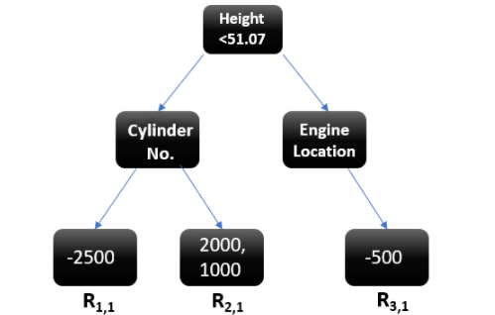
Gradient Boosting Regressor
Suppose this is our regressor tree:
We see 1st residual goes in R_{1,1} ,2nd and 3rd residuals go in R_{2,1} and 4th residual goes in R_{3,1} .

Slide 14
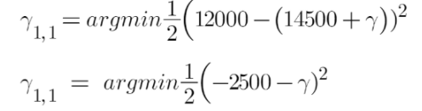
Gradient Boosting Regressor
Let’s calculate the output for the first leave that is R_{1,1}
Now we need to find the value for gamma for which this function is minimum. So we find the derivative of this equation w.r.t gamma and put it equal to 0.

Slide 15
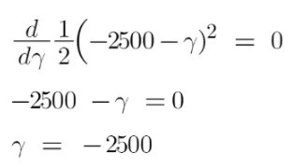
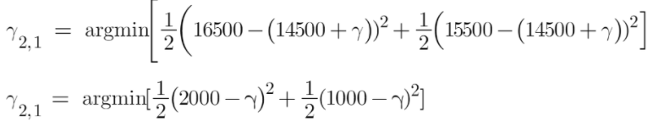
Gradient Boosting Regressor
Hence the leaf R_{1,1} has an output value of -2500. Now let’s solve for the R_{2,1}

Slide 16
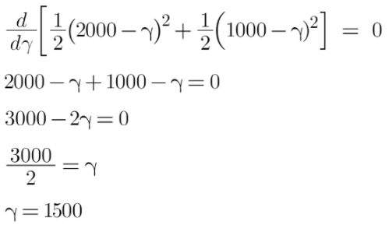
Gradient Boosting Regressor
Let’s take the derivative to get the minimum value of gamma for which this function is minimum:
We end up with the average of the residuals in the leaf R_{2,1} . Hence if we get any leaf with more than 1 residual, we can simply find the average of that leaf and that will be our final output.

Slide 17
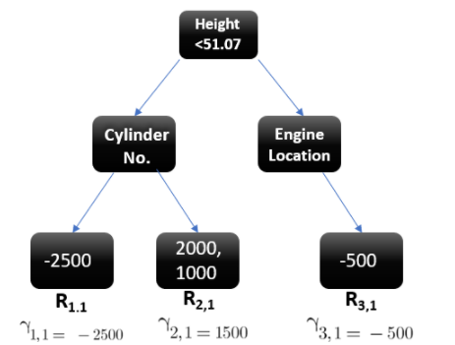
Gradient Boosting Regressor
Now after calculating the output of all the leaves, we get:

Slide 18
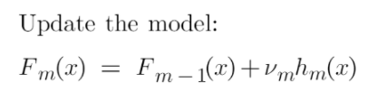

Gradient Boosting Regressor
Step-5 This is finally the last step where we have to update the predictions of the previous model. It can be updated as:
where m is the number of decision trees made.
Since we have just started building our model so our m=1. Now to make a new DT our new predictions will be:

Slide 19
Gradient Boosting Regressor
Here F_{m-1}(x) is the prediction of the base model (previous prediction) since F₁₋₁₌₀ , F₀ is our base model hence the previous prediction is 14500.
nu is the learning rate that is usually selected between 0-1. It reduces the effect each tree has on the final prediction, and this improves accuracy in the long run. Let’s take nu=0.1 in this example.
H_{m}(x) is the recent DT made on the residuals.

Slide 20
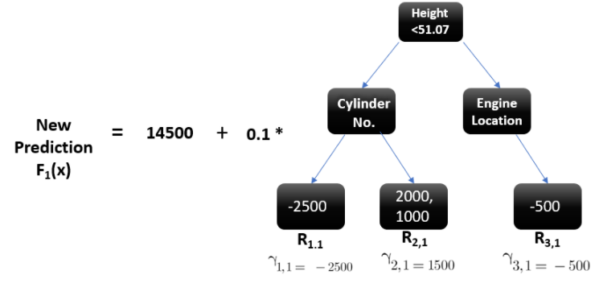
Gradient Boosting Regressor

Slide 22
Gradient Boosting Regressor
Suppose we want to find a prediction of our first data point which has a car height of 48.8. This data point will go through this decision tree and the output it gets will be multiplied with the learning rate and then added to the previous prediction.
Now let’s say m=2 which means we have built 2 decision trees and now we want to have new predictions.
This time we will add the previous prediction that is F₁(x) to the new DT made on residuals. We will iterate through these steps again and again till the loss is negligible.

Slide 23

Thank you

